Slide 1


AUTHLIB
Neo-Authoritarianisms in Europe and the Liberal Democratic Response
WP2 Challenges to liberal democracy, dimensions of empirical research​
​​
Lead SWPS​
​
M2-6 (November 2022 – March 2023)​

Slide 2

Two deliverables & one milestone
D2.1 Literature review: Illiberalism, Authoritarianism and Populism M5​
​
D2.2 Guidelines for empirical data collection M6​
Milestone – Guidelines for empirical data collection M6

Slide 3
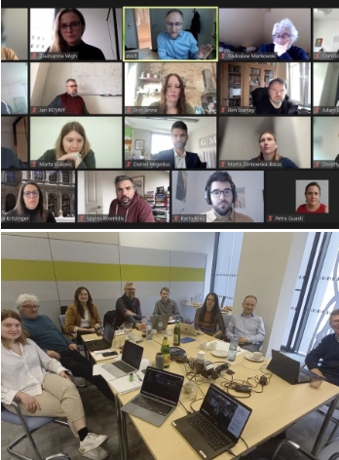
Key meetings
AUTHLIB consortium first virtual workshop on February 24, 2023 ​
Hybrid internal workshop held on March 29, 2023 on-site at the University of Vienna and online​

Slide 4
D2.1 Structure
What is illiberalism?
  Illiberalism as regime type: Illiberal democracies
  Illiberalism as ideology
  Bringing illiberal values and practices together
How is illiberalism different from authoritarianism and populism?
  Authoritarianism
  Populism
  Mapping illiberalism against authoritarianism and populism
  Sequencing illiberalism, authoritarianism and populism
Varieties of illiberalism
Postliberalism
Illiberal liberalism

Slide 5
WP2 = making sense of the rich literature and conceptual order
Populism, illiberalism, and authoritarianism (PIA) used interchangeably
All three challenge different aspects of liberal democracies (LDs), unveil specific traits and manifest idiosyncratic developments.
Divergent factors determine them and are facilitated by different socio-political contexts.
Conceptual order is needed.
PIA regimes competing with LDs placed within the grand frame of recent history, time sequence, and multiple contextual impacts.

Slide 6
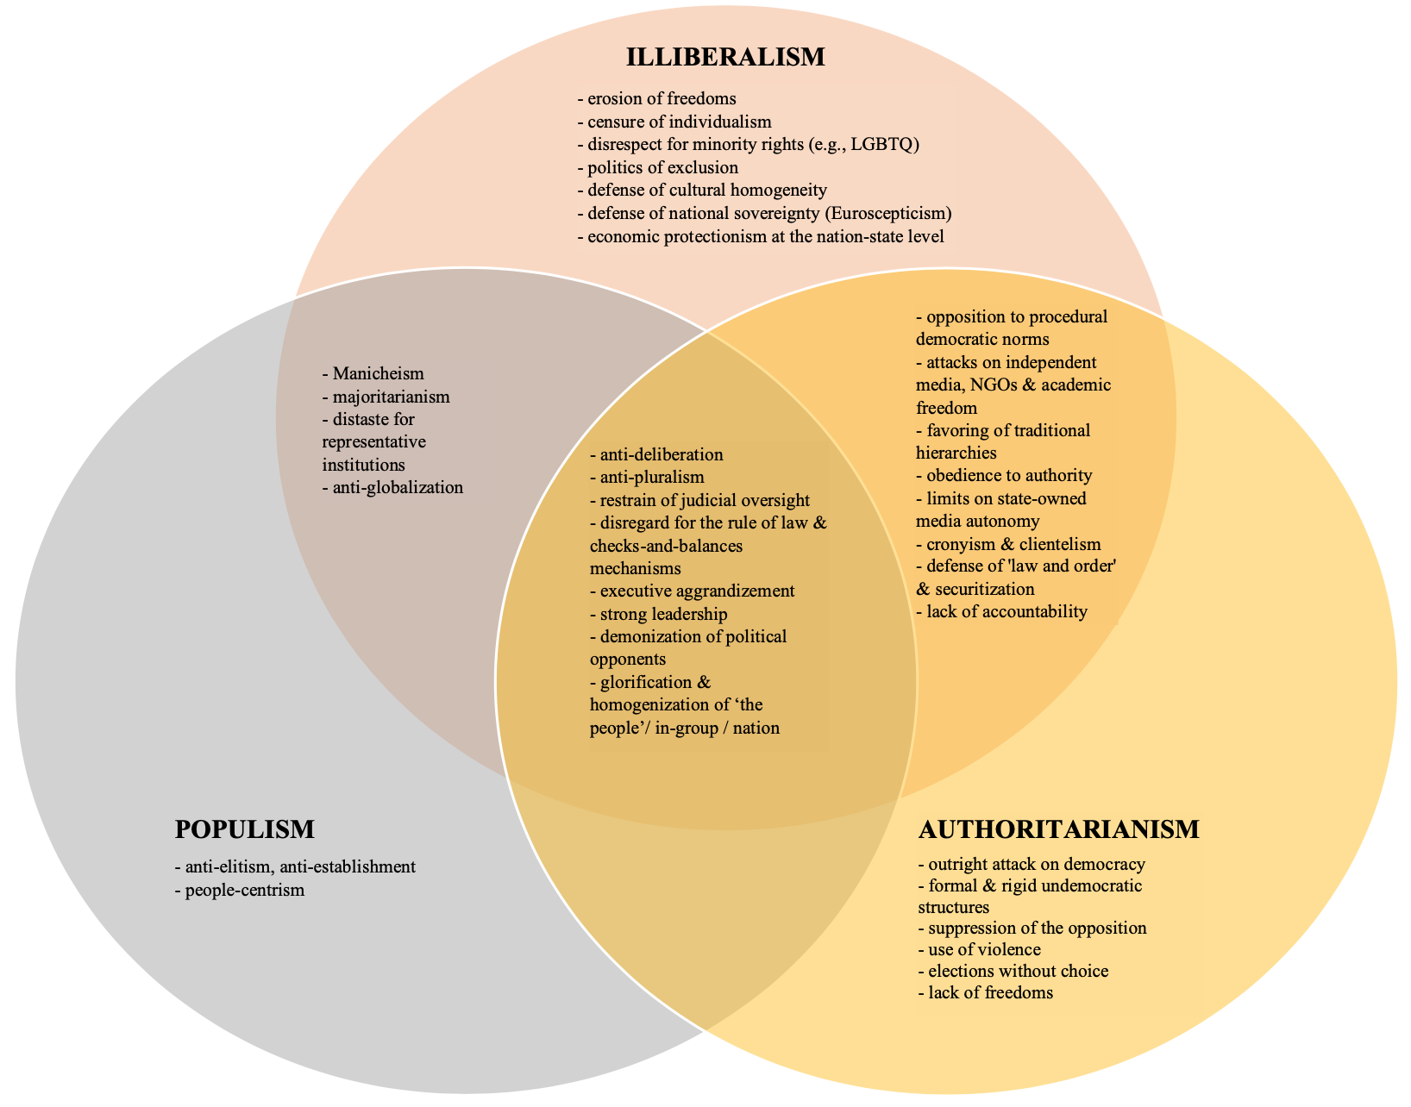
Populism – Illiberalism – Authoritarianism: overlaps & idiosyncrasies

Slide 7
Dynamics
PIA phenomena (as set of ideas, ideologies and regimes) ought to be analized dynamically → their sequence and gradualism
Typically: dismantling of LDs starts with Populism as it is relatively ”easy & low cost” & seems democratically legitimate.
Next: Illiberalism
Next: Authoritarianism
The sequence is by no means deterministic, nor universal.
Reverse developments happen – and depend on the public reaction

Slide 8
D2.2 Guidelines for Empirical Data Collection
Research questions were specified and – where possible – structured hypotheses were put forward.
The levels and units of analysis were identified.
Methods and existing data sources were outlined.
Central issues and dimensions were described.

Slide 9
Key research questions
What are the core constitutive elements of illiberalism and what are the main theoretical varieties of illiberalism?
Which elements of liberal democracy do illiberal citizens/parties oppose and which ones do they endorse? What are the different ideological combinations of political preferences and how are they related to the support and opposition to liberal democracy?
Can one identify inter-/trans-national impact on illiberalism and its particular models?
How can liberal democratic actors respond to illiberal challenges?

Slide 10
Levels of analysis
Ideas and ideology itself
The political operationalization of ideology
The social-political response to ideologies
The nature of party-voter linkages

Slide 11
Central issues
democratic procedures and liberal democratic values
ideological underpinnings of illiberalism
illiberal citizens' psychological traits and attitudes
illiberal practices and policies
international relations, geopolitics, and supra-national institutions
democratic resilience to autocratization / responses to illiberal challenges

Slide 12
AUTHLIB
Neo-Authoritarianisms in Europe and the Liberal Democratic Response
WP4 Survey-based data-collection and experiments on public attitudes
​
Lead SWPS
M7-25 (April 2023 – October 2024)

Slide 13
Five deliverables & one milestone
D4.1 An analysis of the relationship between socio-demographic attributes and the propensity to support particular types of neo-authoritarianism M24
D4.2 A data set that integrates information on the social characteristics of neo - authoritarianism (based on previous surveys – ESS, ISSP, EES, EVS) with the ideological configurations that emerged from WP3 M24
D4.3 A paper including a typology on the distribution of the types of illiberal orientations across the EU Member States M25
D4.4 A data set on the reactions of citizens in experimental setting M25
D4.5 A paper on the survey experiments, focusing on factors shaping attitudes towards liberal democracy M25
Milestone – Finalisation of the survey-based data collection M25

Slide 14
WP4 Main activities in M7-15
Compilation of existing studies, measures, and indicators relevant to the AUTHLIB survey
Design of the survey questionnaire
Design of the survey-embedded conjoint experiment
Preparation of the administration of the tender process

Slide 15
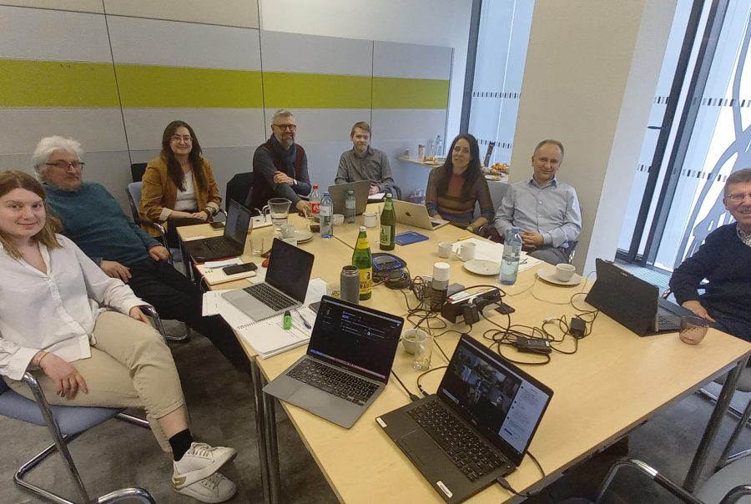
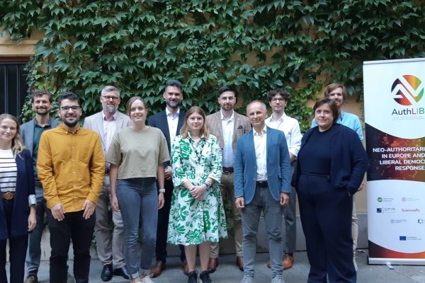
Key meetings
Hybrid internal workshop held on March 29, 2023 on-site at the University of Vienna and online
Meeting at the ECPR General Conference (September 4-8, 2023)

Slide 16
Compilation of existing studies, measures, and indicators
Relevant measures and indicators from the European Social Survey (ESS), World Values Survey (WVS) and European Values Survey (EVS), International Social Survey Programme (ISSP), Comparative Study of Electoral Systems (CSES), Americas Barometer, and other sources were selected after assessing their suitability for AUTHLIB Survey goals and utilization in the extant literature.
Several batteries were analysed using statistical methods such as Principal Factor Analysis and pairwise correlations to assess their consistency and relevance for the project.

Slide 17
Design of the survey questionnaire
Several iterations of the questionnaire
Choice of existing measures and creation new ones
Selection and elimination of items due to the time constraints in administering the online survey (max. 25 minutes, including the experimental module).
The questionnaire is expected to be finalised by the end of March 2024. It consists of 41 questions (some of them with several items in batteries)

Slide 18
Design of the survey-embedded conjoint experiment
Discussions on statistical power, the optimal number of iterations per participant, and the number and levels of attributes.
Key attribute: varying levels of populism, illiberalism, and authoritarianism in a party’s policy implementation, together with its positions on cultural and economic issues
Three iterations of three separate forced choice selections to cover PIA violations of: democratic principle of rule of law, free and fair elections, and civil liberties.
We are finalising the design and refining the specific wording
Total number of conjoint forced choices is 9 and the estimated time 7 minutes

Slide 19
Preparation of the administration of the tender process ​
SWPS official tender procedure will be announced in public information bulletin with at least 14 days of period for submitting bids​
Technical requirements:
  Technical ability to conduct the study and prior experience in conducting cross-country studies;
  Experienced project manager; ​
  Access to panels ≥ 10,000 individuals in each of the countries of study; ​
  Access to survey networks in Poland, Czech Republic and Hungary​ - CAPI complement to CAWI to increase representativeness;
Selection criteria: not only economic, also related to the expected quality of the gathered data

Slide 20
WP4: STEPS AHEAD
Finalising the design of the AUTHLIB Survey Questionnaire (March 2024)
Finalising the design of the AUTHLIB Survey Conjoint Experiment Module (April 2024)
Translating AUTHLIB Survey into local languages (April-May 2024)
Finalising the tender process: selection of the subcontractor (April-May 2024)
Collaboration in survey programming and pre-testing (May-June 2024)
Quality assurance in sampling, fieldwork and data (June 2024)
Finalisation of the dataset and handing-in of the deliverables of WP4 (June-October 2024)

